Slide 1



How Can We Support Our ESOL Students During Virtual Learning?
Presented by Geri McClymont,
ESOL teacher at Potomac MS
This Photo by Unknown Author is licensed under CC BY

Slide 2




English learners are among our most vulnerable students.
They are among those most at risk for falling further behind academically.

Slide 3
Double Challenge
1. Language Barrier (they are learning a new language)
2. Technology Limitations (some have limited or no prior experience with computers)

Slide 4

We want to lower their affective filter to facilitate their success in class.
The affective filter is a psychological filter that can facilitate or hinder learning.

Slide 5
When the filter is high, students are stressed, lack confidence and shut down.
When the filter is low, students feel safe, take risks, and are not afraid to make mistakes.

Slide 6
HOW DO WE SUPPORT OUR ESOL STUDENTS?
→ Know their language level
→ Offer them accommodations based on their language level
→ Modify assignments and assessments based on their language level
→ Apply ESOL strategies in class
→ Teach them basic technology skills
→ Communicate with their parents/guardians in their preferred language

Slide 7
Possible accommodations:
● Translators
● Bilingual dictionaries
● English dictionaries
● Read assignments and assessments aloud to them
● Graphic organizers
● Word banks
*The accommodations you provide your ELs will depend on their language level.

Slide 8
Some ways to modify assignments and assessments:
● Provide a version with simplified language
● Simplify directions
● Provide fewer questions or test items
● Offer fewer multiple-choice response options
● Read questions aloud
● Supply word banks
● Provide matching (word-picture) or sorting activities
● Offer extended time
● Allow students to respond orally
*The modifications you make for your ELs will depend on their language level.

Slide 9

Simple Strategies can make a big difference for our ESOL students!
Examples:
-Speak more slowly
-Use fewer words
-Use many images
-Pre-teach key vocabulary
-Graphic organizers
-Model what you teach
This Photo by Unknown Author is licensed under CC BY-ND

Slide 10
Student Friendly Canvas Course Layout will help our ESOL students succeed!
Suggestions:
-Use date header each week
-Drag current module to top of page
-Only publish current and past modules
-Simplify names of modules (keep it short and to the point)
-Make it easy for students to find what they need

Slide 11
For resources to support ESOL students, please visit the PTMS ESOL page, under “Our School”.

Slide 12
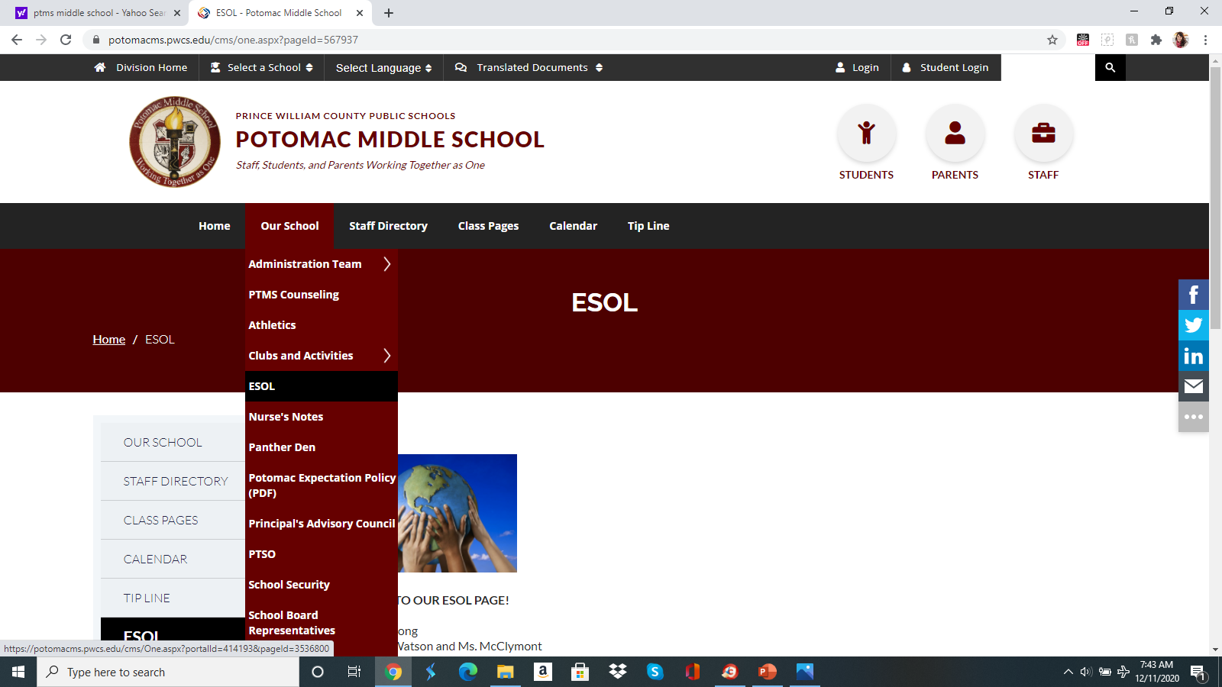

Slide 13
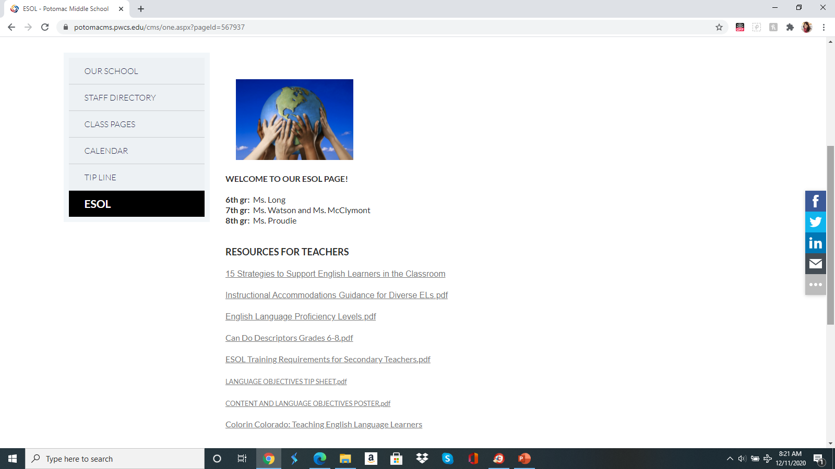

Slide 14

Thank you for all you do to support our English learners!

